Slide 1
Google Play vs Apple Store
Group 8 Xuanyi Yang Wenmiao Yu

Slide 2
Contents
Background and Motivation
Methods
Dataset
Single dataset analysis
Dataset comparison analysis
Conclusion

Slide 3
Background and Motivation
Massive number of apps
What does an app store look like?
Two largest mobile app stores
Google Play
Apple Store
Presumably, app stores should look similar
Is there any difference?
Helpful to developers

Slide 4
Methods
What does an app store look like?
Exploratory Data Analysis (EDA)
Relation Analysis: Regression
Kernel Density Estimation (KDE)
Is there any difference?
Compare statistics and estimations from dataset
Compare apps that both stores have

Slide 5
Datasets
Google Play dataset from Kaggle
Scraped in 2018, updated 6 months ago
7600 apps
Old Apple Store dataset from Kaggle
Scraped on July 2017
7198 apps
New Apple Store dataset
Scraped last week
Most popular 250 apps of each category

Slide 6
Datasets
Converted strings to numbers
Splitting strings
Size: K to 1000, M to 10^6
etc.
Deleted repeated rows
Renamed columns
Re-assigned category of Google Play apps

Slide 7
Google Play Dataset Analysis
Price
Installs
Reviews
Rating
5 Features
Size

Slide 8
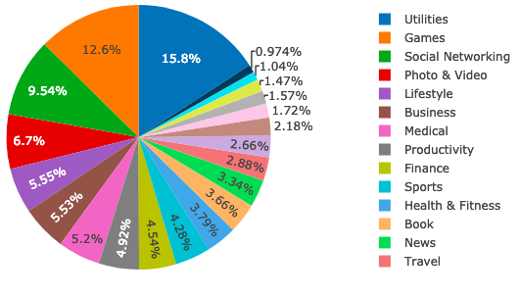
Data Overview
7600 apps → 14 categories
Utilities and Games apps have the highest market prevalence.
Social Networking, Photo & Video, Lifestyle and Business apps are also catching up.

Slide 9
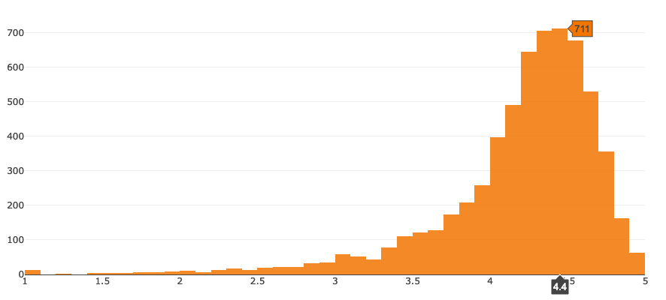
Distribution of Ratings
Average app rating : 4.1704

Slide 10
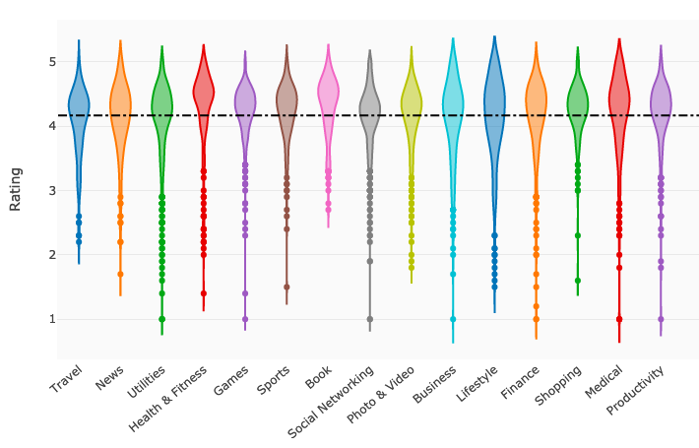
App ratings across major categories
Similarity
thicker part
--->higher frequency

Slide 11
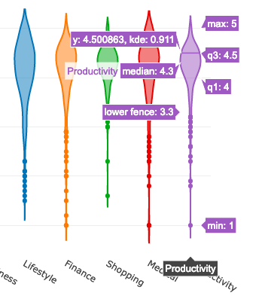
App ratings across major categories
Max, Min
Median

Slide 12
App ratings across major categories
Health & Fitness produces the highest quality apps.
On the contrary, Travel, News, Utilities, Business, Lifestyle have a rating lesser than the average rating.

Slide 13
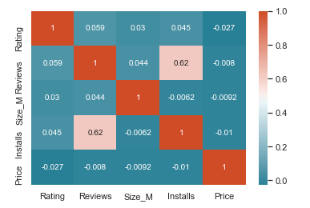
Correlations
Reviews & Installs : 0.62,
which is much higher than any other coefficients !
So?

Slide 14
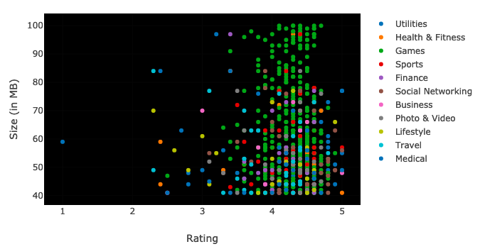
Size & Ratings
There is no such strong correlation between Size and Ratings.
Most bulky apps with high ratings are games.

Slide 15
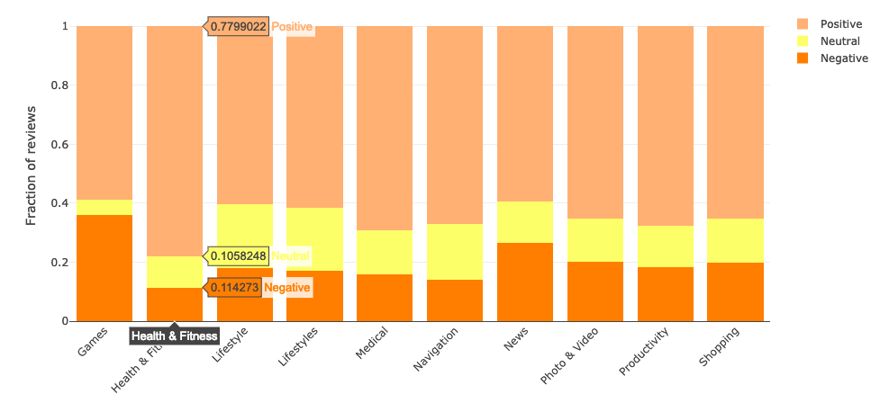
App Reviews
Health and Fitness apps perform the best, having more than 77% positive reviews.
Games and News apps perform bad leading to less than 60% positive reviews..

Slide 16
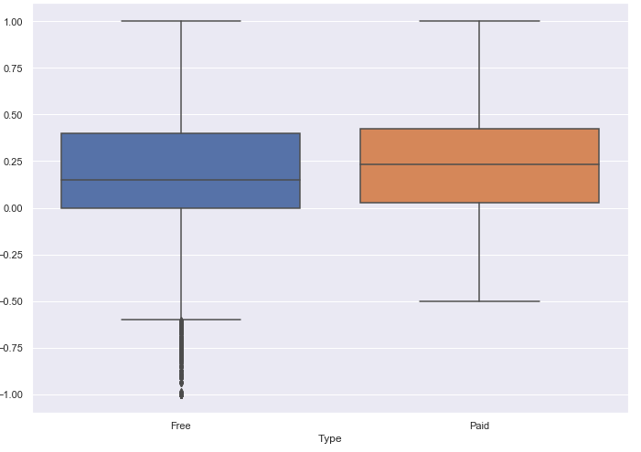
App Reviews--Sentiment Polarity Distribution
Users are more tolerant while reviewing paid apps.

Slide 17
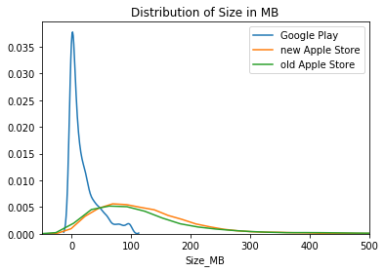
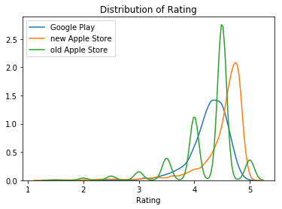
Comparison Analysis: Statistics and Estimation
Notes:
Let me talk about the comparison analysis. As statistics and estimation are more representative, due to limited time, i’ll just focus on this. Performance of shared apps can be found in our repo. I picked most popular 3k apps from each store using number of reviews as filter.

Slide 18
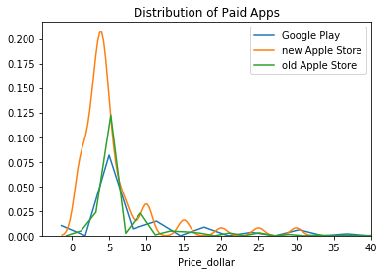
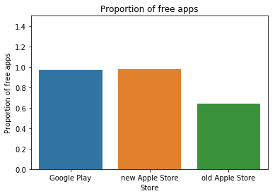
Comparison Analysis: Statistics and Estimation

Slide 19
Conclusion
Dataset Analysis
More reviews, more numbers of the downloads
Users are more tolerant of paid apps
Comparison
Apple Store: rating increased, more free or cheap apps
Google Play: decent download size

Slide 20
Thank you!
Q & A

